Slide 1


High Pressure Systems Safety Training
Things to Consider
Hazards of High Pressure Systems
BLEVEs
Compressed Gas Cylinders
Safety Factors
Design Standards
Material Compatibility
Cryogenic Considerations
Pressure Vessels
Testing
Training & Qualifications
Safe Distances and Barricading

Slide 2
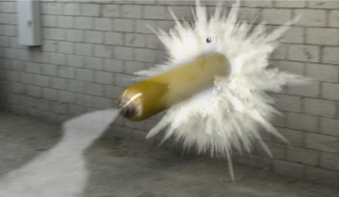
Things to Consider
A standard compressed gas cylinder can store the equivalent energy of 1 lb of TNT
A Strong blast of ordinary compressed air or gas from a hose can dislodge an eye from its socket, rupture an eardrum, or induce hemorrhage.
A 100 psi gas jet discharged from a 1/8” opening at the surface of the skin can enter and inflate the flesh, even causing bubbles in the bloodstream.
A stream of air under 40 psi from a hose can drive metal chips fast enough to penetrate the eyes or skin.
A failed hose or fitting can whip dangerously and potentially cause serious injury.

Slide 3
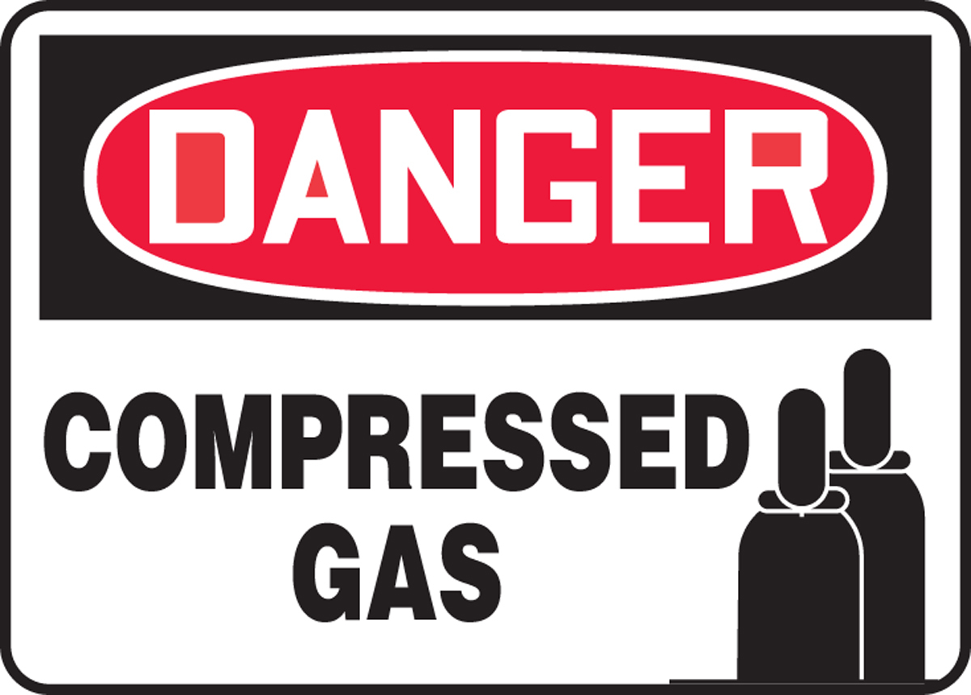
Hazards of High Pressure Systems
The Fluids Themselves
Gases / liquids may be flammable, toxic, oxidizing, asphyxiant, etc and pose a hazard if they leak.
The fluids may also cause deterioration or other adverse affects with materials in the system.
The Stored Energy
Significant energy is stored when a gas is compressed.
Fluid may also contain additional energy if reactive (e.g. N₂O), or if superheated (e.g. room temp N₂O).
A gas at a given pressure stores far more energy than a liquid at the same pressure.
AKA always test with water first!
…Learning to mitigate the hazards is critical!

Slide 4
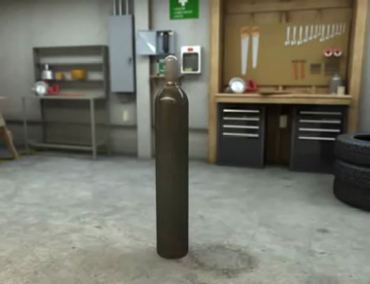
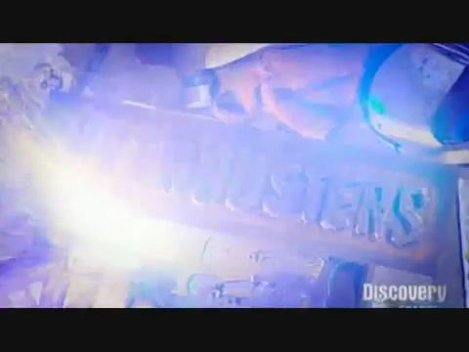
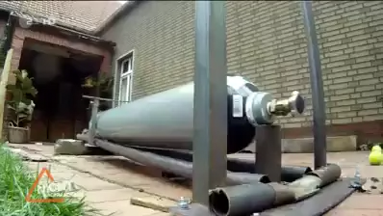
Hazards of High Pressure Systems

Slide 5
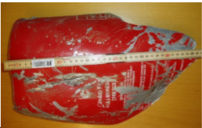

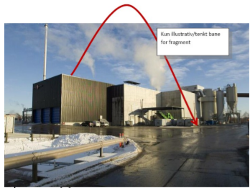
BLEVE’s
What is a BLEVE?
Boiling Liquid Expanding Vapour Explosion.
Sudden release of a large mass of pressurized superheated liquid to the atmosphere.
May cause blast waves, dangerous shrapnel propelled by rapid expansion of the fluid.
One Example
Small CO₂ fire extinguisher (5 kg liquid) thrown in dumpster
Taken to waste disposal facility, sent through shredder
Cylinder burst into several fragments.
One weighing 1.9 kg flew through a double layer steel roof and landed 35 m away.

Slide 6
BLEVE’s
A Cryogenic Example
Accident at a university, involving an old liquid nitrogen cylinder.
Pressure relief valve and rupture disk had failed at some point in the past.
Someone at the university decided to “fix” the cylinder by removing and capping the failed devices.
Cylinder had been standing at one end of a lab on the second floor of the chemistry building.
Was on a 4-6” thick concrete floor, covered in tile, directly over a reinforced concrete beam.
…What happened??

Slide 7
BLEVE’s
The Aftermath
Inner tank expanded until it was constrained by the outer jacket.
Continued expanding lengthwise, until bottom weld failed @ 1200 psi.
Explosion blew all the tile off the floor in a 5’ radius, shattering them into small pieces of shrapnel that embedded themselves in the walls and doors of the lab.
Door and wall of the lab blown out into the hallway.
All remaining walls blown 4-8” off their foundations.
All windows blown out into the courtyard.
Blast cracked the floor. Supporting beam shattered.
Cylinder was propelled through the concrete ceiling into a mechanical room above.
Struck two 3” water mains, drove them into the concrete roof of the building and cracked it.
Cylinder came to rest on the third floor, leaving a 20” diameter hole.

Slide 8
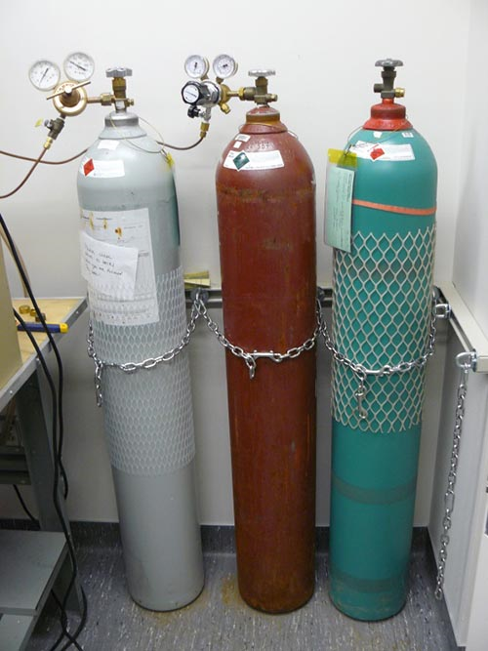
Compressed Gas Cylinders
What is a Compressed Gas?
According to DOT: Any material or mixture which exerts in the packaging an absolute pressure of 280 kPa (40.6 psia) or greater at 20ºC
How is it Supplied?
Typically in heavy steel cylinders, in a range of sizes.
Pressures typically around 2200 psi for inert gases such as nitrogen, helium, air.
Higher pressure cylinders also available (typically to 6000 psi)
Different Fittings for Different Gases
Cylinder valves have different types of connections depending on what the gas is.
CGA (Compressed Gas Association) defines standards.
E.g. CGA 580 (inert gas)
This is an important safety feature - don’t use adapters!

Slide 9
Compressed Gas Cylinders
Storage
Store gases in compatible areas. Store fuel and oxidizers in separate areas.
Store gas cylinders upright and chained in position to prevent falling over.
Cylinders should not be heated above 50ºC, or chilled below -40ºC.
In freezing weather, keep cylinder valves dry.
Transportation
Protective cap must be in place prior to moving. NEVER transport a cylinder with a pressure regulator still attached.
Handle carefully: never drop cylinders or permit them to strike each other violently.
Cylinders are heavy and cumbersome: use a cylinder dolly when transporting and ensure the cylinder is strapped in place.

Slide 10
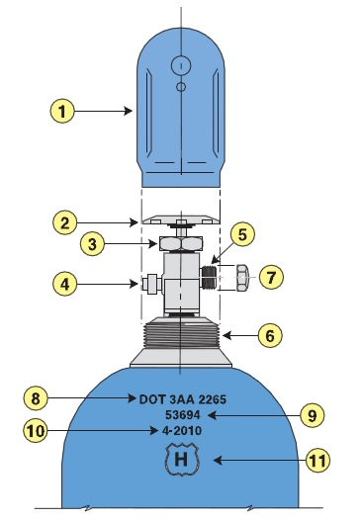
Compressed Gas Cylinders
Use
NEVER tamper with pressure relief devices on valves or cylinders.
Use only in a well-ventilated area and wear appropriate PPE (eye protection at minimum).
Never lubricate or use Teflon tape on the gas cylinder (CGA) fitting.
Only use regulators and pressure gauges with the gases for which they were intended.
When cylinder is connected to a regulator / system, open the cylinder valve SLOWLY and check for system leaks.
Ensure line connecting cylinder to system is depressurized before disconnecting.
Never discharge a cylinder below 25 psi, to prevent contamination.
Do not have full and empty cylinders connected to the same manifold: reverse flow can occur.
Also be aware of the additional hazards relating to the specific contents of a given cylinder!

Slide 11
Safety Factors
Ratio of ultimate strength of the material to allowable stress.
Based on the maximum pressure the vessel / system will ever be expected to experience, accounting for transients and off-nominal conditions.
Design FoS for a given component / system based on:
Whether people are exposed to injury
Whether equipment is protected from explosion
Standard practice: FoS ≥ 4 when people are directly exposed.
Safety Factor | Condition
4 | Mechanical and shock loading not excessive
6 | Considerable shock and mechanical strain
8 | Hazardous applications with severe service

Slide 12
Cryogenic Considerations
Boiling of Fluid
Any volumes of a system where fluid can become trapped must provide a means of pressure relief.
Otherwise, overpressure and possibly rupture can occur as the cryogen boils
Insulation
Longer-term cryogenic service will require insulation.
Cold, uninsulated surfaces of cryo systems can cause burns if touched.
If there is a risk of LOX spilling onto insulation, ensure compatibility: many insulation materials are highly flammable.

Slide 13
Cryogenic Considerations
Valves
Key problem areas are:
Heat leakage
Distortion from temperature gradients
Freezing of the packing
Icing and sticking of parts that must move
Maintaining seat load despite thermal shrinkage
Industrial cryogenic valves are available that address these areas:
Extended stem to keep packing warm
Springs to maintain seat loads
Upstream vents (ball valves) to prevent overpressure

Slide 14
Testing Components and Systems
Proof Testing
Essential test for any newly-manufactured pressurized components – especially pressure vessels.
Objective is to test to a stress level greater than normal operating conditions, but not so great as to compromise the tank (e.g. cause general yielding).
Always done with water / incompressible fluid – never gas!
Ensure all air is bled out of tank.
Tanks may fail: personnel must be at a safe distance / behind a solid barrier.
Should be done BEFORE final cleaning.

Slide 15
Testing Components and Systems
Burst Testing
Destructive test to determine actual burst pressure of the as-manufactured tank.
Can also give an indication of what the weak point is.
Must always be done with water / incompressible fluid – never gas!
Ensure all air is bled out of tank.
Personnel should be at a safe distance, ideally behind a barrier.
May be required for aggressive designs with low margins.
Note: it is not uncommon for tanks to fail at a small fraction of their design pressure.
Welds and other stress concentrations are the most common failure points.
Composite tanks are particularly violent when they fail.

Slide 16

Testing Components and Systems
Cold Shock Testing
For systems that will see cryogenic services (particularly pressure vessels)
After final assembly, chill down with clean LN₂
Drain, allow to warm, re-torque connections.
Inspect for signs of:
Cracking
Distortion
Other anomalies
Pay particular attention to welds, joints.

Slide 17
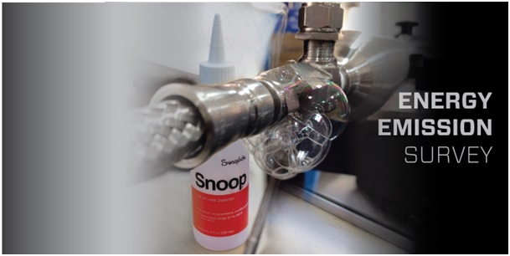
Testing Components and Systems
Leak Testing
Important test for components with their own leak paths (valves, regulators), as well as systems.
Should be performed any time a change to the system that could impact leak-tightness has occurred.
Helium is ideal test fluid: good at finding its way out of things.
For safety, leak tests should be done at pressures well below normal operating.
Typically <100 psi, and not more than 25% of operating pressure.
Check for leaks with soap solution or leak detector.
De-pressurize system prior to tightening or disassembling any leaking connections!

Slide 18
Operations
Safe Distances & Barricading
For any operations using an unproven system, or one not built and tested in accordance with ASME B13.3, must assume the system could fail.
Protection from failure should involve some combination of:
Distance
Barricading
Protection must account for BOTH shrapnel and blast (overpressure).
Remember: barricades are only useful if they are secure and adequate.
Otherwise, could simply become additional shrapnel!
Remember: there is more energy in a high pressure system than you might think.

Slide 19
Operations
Training & Qualification
Use caution and common sense.
“Buddy” system
Team members performing an operation should be thoroughly familiar with:
The operation
The fluid(s)
The hazards involved
The appropriate PPE
THERE WILL BE TRAINING ASSOCIATED WITH EACH EXPERIMENT AND ALL MEMBERS INVOLVED WILL NEED TO BE FAMILIAR WITH EXPERIMENT DOCUMENT AND PROCEDURES

